Slide 1
OAuth 2 Introduction
Roles
Grant Types
Flows
Demo

Slide 2



OAuth Roles
Resource Owner ( User )
Client ( Application that wants to access user account )
Resource Server ( API ) Hosts User Accounts
Authorization Server ( API ) Verifies the Identity
Authorisation
Server
Auth. Request
Token
Token
Resource
Server
Resource
Resource Owner

Slide 3
Authorization Grant
1. Authorization Code: used with server-side Applications
2. Implicit: used with Mobile Apps or Web Applications (applications that run on the user's device)
3. Resource Owner Password Credentials: used with trusted Applications, such as those owned by the service itself
4. Client Credentials: used with Applications API access, example use case, changing application settings (authorization based on with client_id, client_secret)
5. Refresh token grant: used to obtain an access token with a refresh token

Slide 4
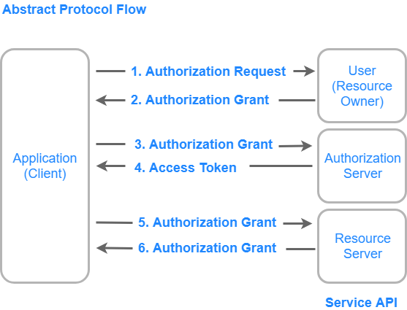
General Overview

Slide 5
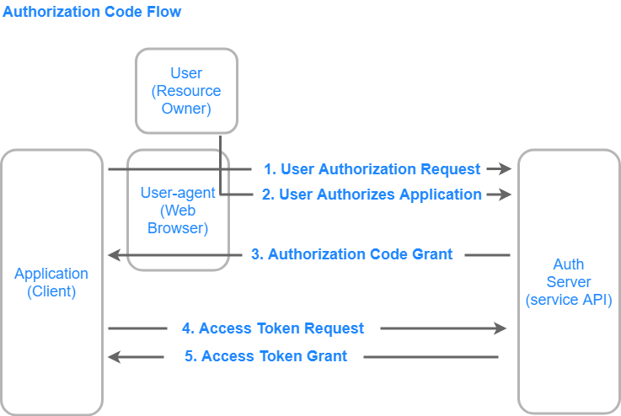
1. Authorisation Code Grant Type

Slide 6
1. Authorisation Code Grant Type
1. Application requests AUTHORISATION_CODE
https://cloud.digitalocean.com/v1/oauth/authorize?response_type=code&client_id=CLIENT_ID&redirect_uri=CALLBACK_URL&scope=read
2. User authorizes
3. Application receives AUTHORISATION_CODE
https://dropletbook.com/callback?code=AUTHORIZATION_CODE
4. Application requests ACCESS_TOKEN
https://cloud.digitalocean.com/v1/oauth/token?client_id=CLIENT_ID&client_secret=CLIENT_SECRET&grant_type=authorization_code&code=AUTHORIZATION_CODE&redirect_uri=CALLBACK_URL
5. Application receives ACCESS _ TOKEN

Slide 7
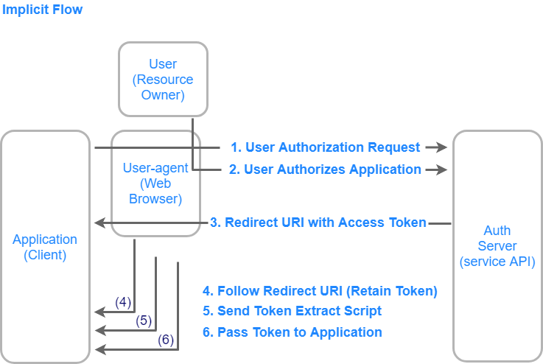
2. Implicit Grant Type

Slide 8
2. Implicit Grant Type
1. Application requests authorisation
https://cloud.digitalocean.com/v1/oauth/authorize?response_type=token&client_id=CLIENT_ID&redirect_uri=CALLBACK_URL&scope=read 2. User Authorizes Application
Step 3: User-agent Receives Access Token with Redirect URI
https://dropletbook.com/callback#token=ACCESS_TOKEN
Step 4: User-agent Follows the Redirect URI
Step 5: Application Sends Access Token Extraction Script
Step 6: Access Token Passed to Application

Slide 9
3. Grant Type: Resource Owner Password Credentials
Requesting a Token Based on User Credentials
https://oauth.example.com/token?grant_type=password&username=USERNAME&password=PASSWORD&client_id=CLIENT_ID

Slide 10
4. Grant Type: Client Credentials
Requesting Token Based on Application Credentials
https://oauth.example.com/token?grant_type=client_credentials&client_id=CLIENT_ID&client_secret=CLIENT_SECRET

Slide 11
5. Grant Type: Refresh Token
Requesting Token Based on a Refresh Token
https://cloud.digitalocean.com/v1/oauth/token?grant_type=refresh_token&client_id=CLIENT_ID&client_secret=CLIENT_SECRET&refresh_token=REFRESH_TOKEN

Slide 12

acebook APP Configuration
Facebook APP Creation
Set Redirect URL
Facebook APP Configuration

Slide 13
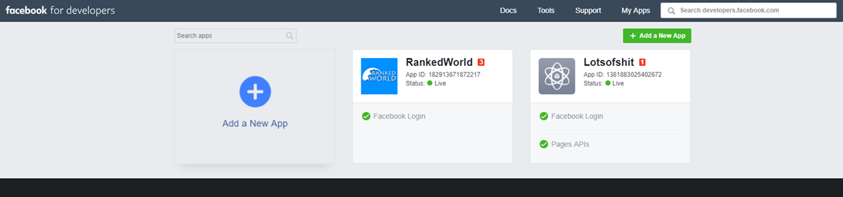
1. Facebook APP Creation

Slide 14
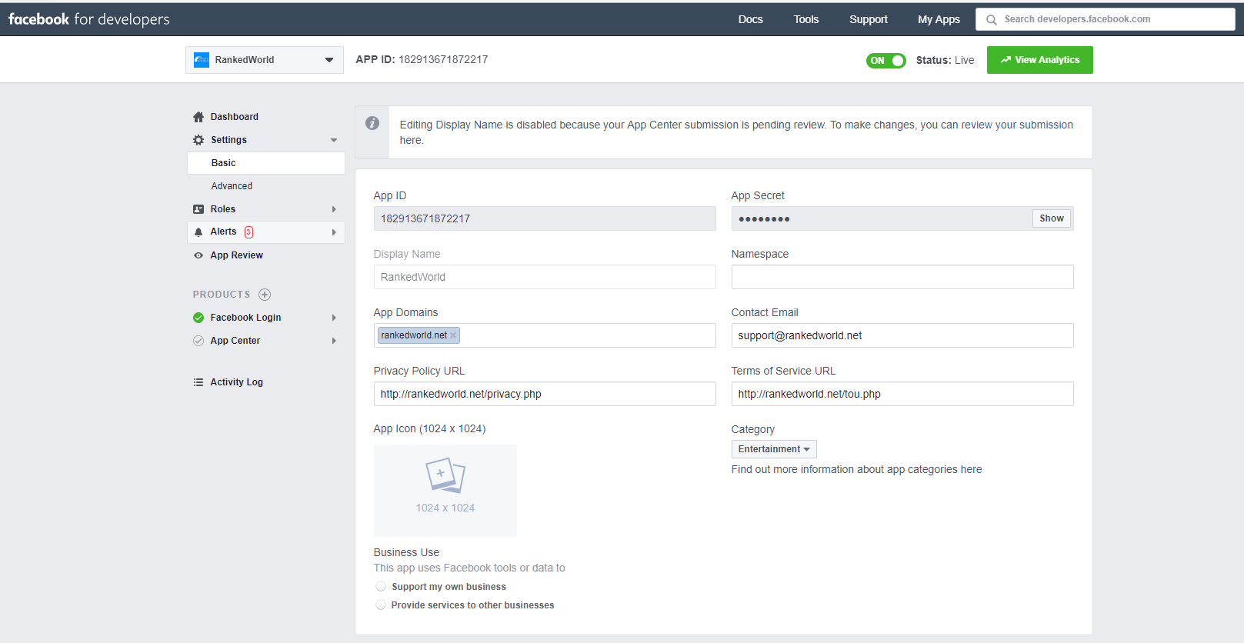
2. Check Basic Information

Slide 15
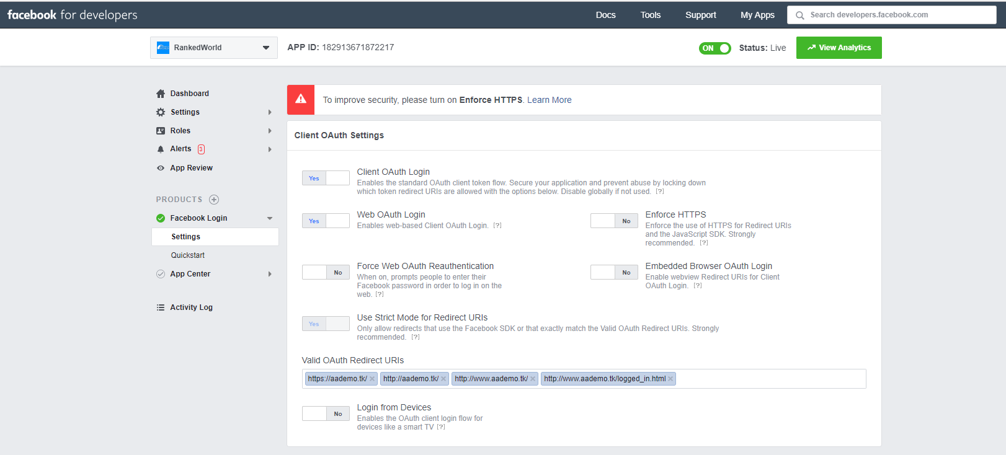
3. Facebook APP Configuration

Slide 16
OAuth MicroService Architecture Integration
General Overview
Implicit Flow
Authorization Code Flow

Slide 17
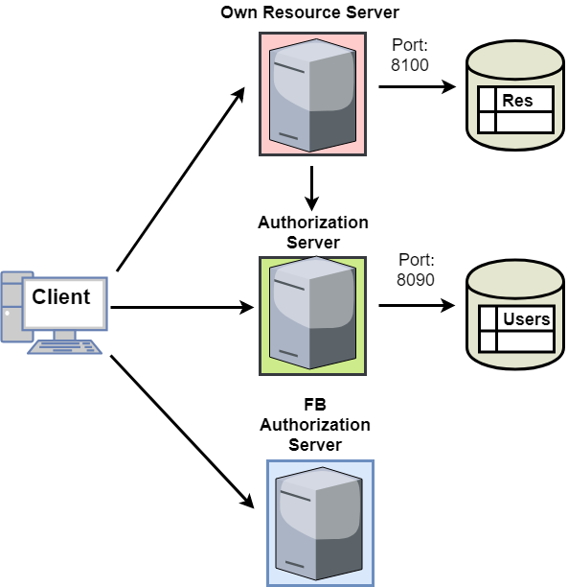
1. General Overview

Slide 18
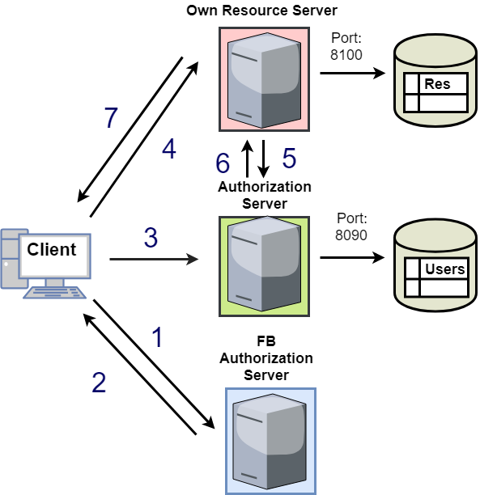
2. Implicit Flow
Access Token Request
User Receives Access Token
Client Registers User
Client Requests Resource
Resource Server Checks Token
Authorization Server Responds
User Receives Resource

Slide 19
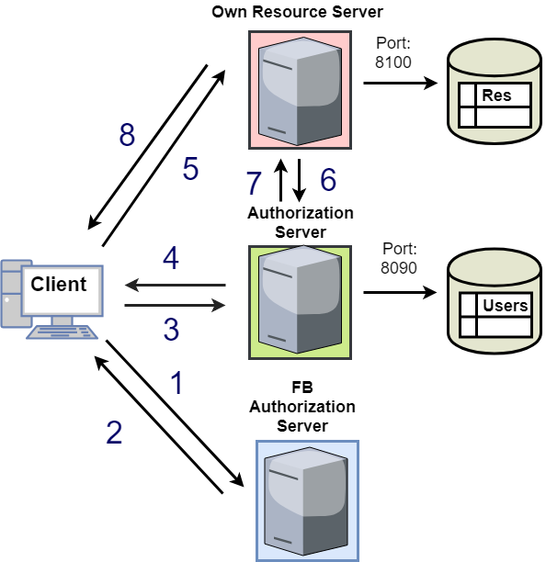
3. Authorization Code Flow
Authorization Code Request
User Receives Authorization Code
Client Sends Auth Code
(in the Background Code -> Token)
Client Receives App Token
Client Requests Resource
Resource Server Checks Token
Authorization Server Responds
User Receives Resource

Slide 20
Auth Code – Access Token Exchange
Request Authorization Code
var facebookAuthEndpoint = “https://www.facebook.com/v2.10/dialog/oauth” +
"? response_type= code " +
"& client_id= 182913671872217 " +
"& redirect_uri= http://www.aademo.tk/logged_in.html” +
+ "& scope= public_profile user_friends”;
Request Access Token
var userEndpoint = "https://graph.facebook.com/v2.10/oauth/access_token?" +
"client_id=182913671872217&" +
"redirect_uri=http://www.aademo.tk/logged_in.html&" +
"client_secret=b6b84d379d3d5006ecaf0eb2dd6f0cac&" +
"code=" + code;

Slide 21
Demo
http://www.aademo.tk

Slide 22
Thank You!
Resources used:
https://www.digitalocean.com/community/tutorials/an-introduction-to-oauth-2
https://dzone.com/articles/oauth2-implicit-grant-flow-example-using-facebook
https://developers.facebook.com/docs/php/howto/example_retrieve_user_profile
https://developers.facebook.com/docs/facebook-login/access-tokens
https://developers.facebook.com/docs/facebook-login/manually-build-a-login-flow
Resources Created
https://github.com/kkocs/OAuth2_Demo

